Slide 1


Stayze Rental Prediction
Team : GreyElectrons
Team Member : 1 .Ashwin Tiwari
2. Iftekar Patel
3. Surojit Nath
4. Rizwan Alvi

Slide 2
Problem Statements :
The stakeholders with the help of the available data want to know the ideal prices at which the properties can be rented, as it will help them decide upon the ideal investment to be done.
understand the customers' and providers' (hosts) behaviour and performance on the platform, guiding marketing initiatives, implementation of innovative additional services.

Slide 3
Potential Business Problems :
To predict the ideal prices at which the properties can be rented.
Investment for the stakeholder depending upon the Location and room type in demand .
Number of host ,listing their properties.
Availability of the house.
Stakeholder :
1. CXO
2.Sales,Public relation Manager,Host and Marketing
3. Finance planning analysis department
4.Operation Team

Slide 4
Data :
The data consist of records of roughly 35000 customer booking and 16 features. There are 15 predictors and one target that price of the hotels listed on the website
Features with the target entity are listed below
Id | listing ID
name | name of the listing
host_id | host ID
host_name | name of the host
neighbourhood_group | location
neighbourhood | area
latitude | latitude coordinates
longitude | longitude coordinates
room_type | listing space type
minimum_nights | amount of nights minimum
number_of_reviews | number of reviews
last_review | latest review
reviews_per_month | number of reviews per month
calculated_host_listings_count | amount of listing per host
availability_365 | number of days when listing is available for booking
price(Target) | price in dollars

Slide 5
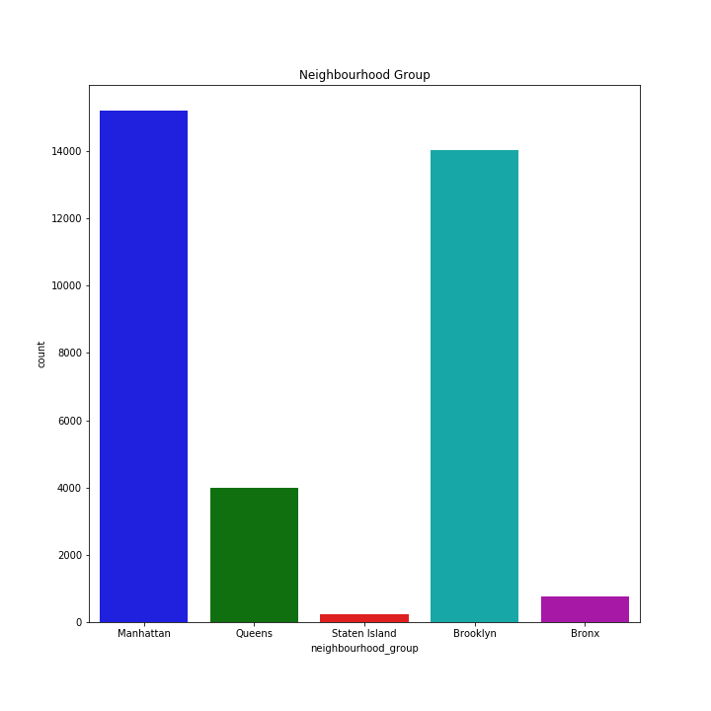
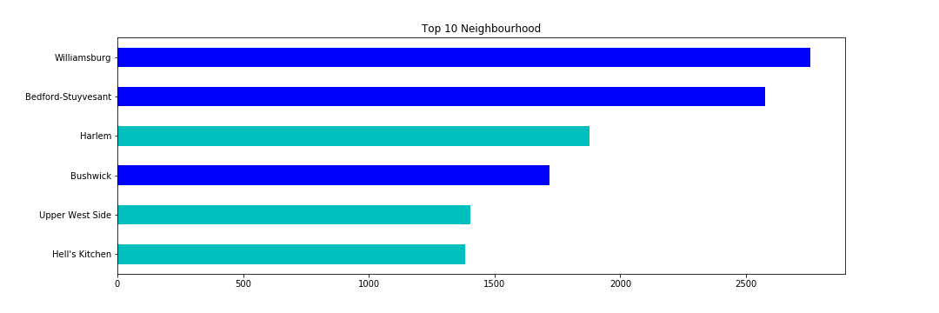
Analysis of Data :
We notice that Staten Island and the Bronx are highly underrepresented in this dataset. For Staten Island, the reason is that the population of the island is small. However, this can't be the case for the Bronx which has a population comparable (~1.4mln) to Manhattan (~1.6mln) or for Brooklyn /Queens with their populations of ~2.5mln and ~2.3mln, respectively.
This makes sense: Queens, the Bronx and, to a fair extent Brooklyn, are residential neighborhoods unlike Manhattan which is a business Centre as well as a tourist destination.
Recommendation for Marketing and public relation team:
Below combination are favorable place for house renting .
Brooklyn with neighborhood like Willamburg , Bedford-Stuyvesant ,Bushwick.
Manhattan with neighborhood like Harlem, Upper West Side and Hell's Kitchen.

Slide 6
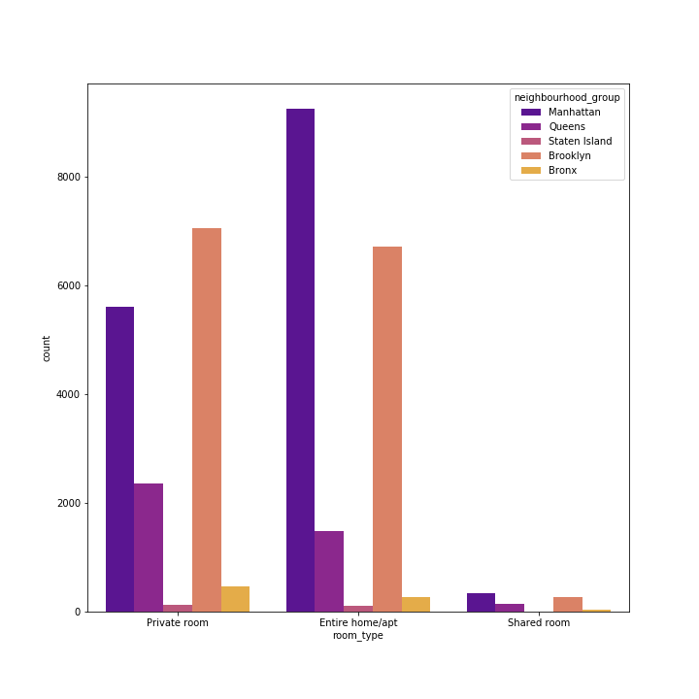
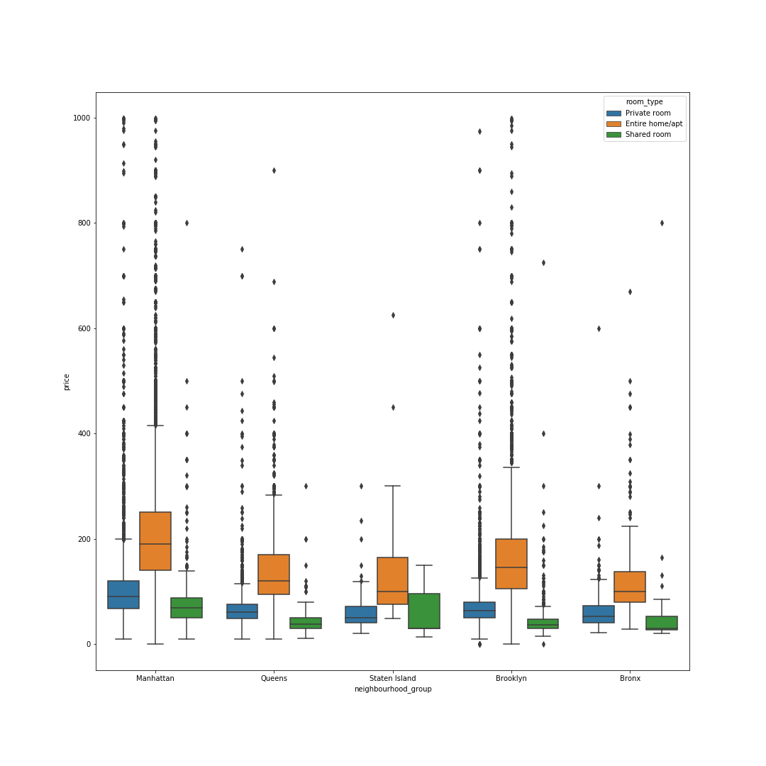
Analysis of Data :
Entire home/Apartment and Private room are more in demand in Manhattan.
Private room and Entire home/Apartment are in demand in Brooklyn
Shared Room are not much in demand in any of the neighborhood.
Prices of all type of room is higher in Manhattan as compare to other Neighbor followed by Brooklyn and Queens.
Recommendation for Marketing and Finance team :-
we should invest more in Manhattan that too in private and entire apartment because revenue generation will be more. Avoid investment in shared room because people are least interested.

Slide 7
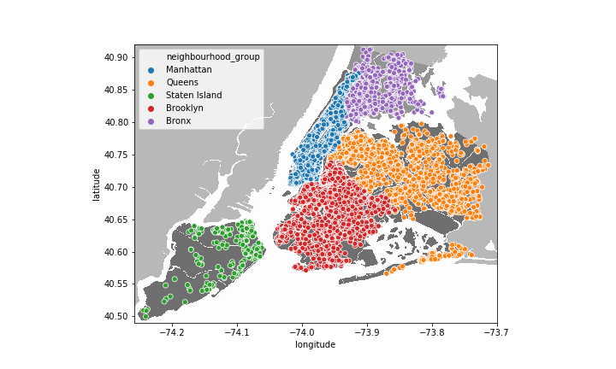
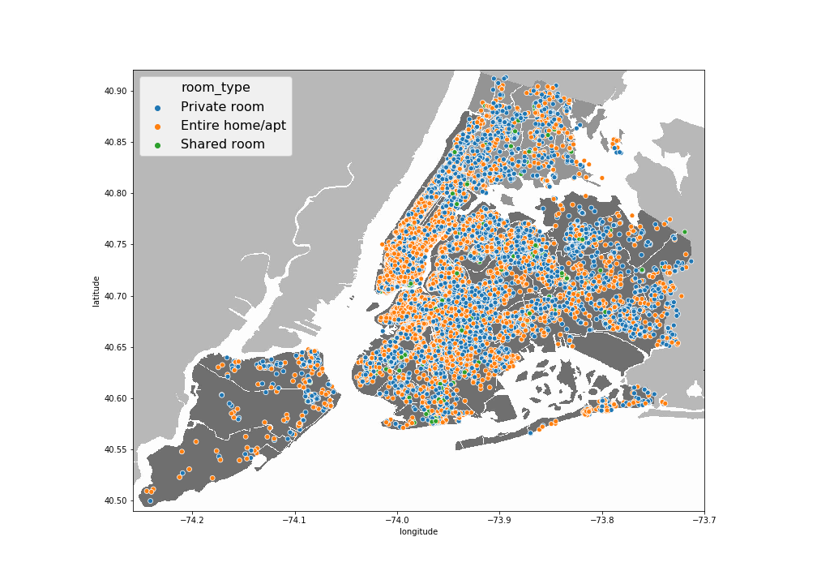
Quantitative Analysis of Data :
Densely populated city is Manhattan followed by Brooklyn.
Neighboring cities like Bronx and Queens have population more concentrated toward Brooklyn and Manhattan.
Overall concentration of private and Entire apartment is approximately equal in Manhattan and Brooklyn.
Recommendation for Marketing and FinanceTeam :-
Areas adjacent to Brooklyn and Manhattan should also be considered while investing.

Slide 8
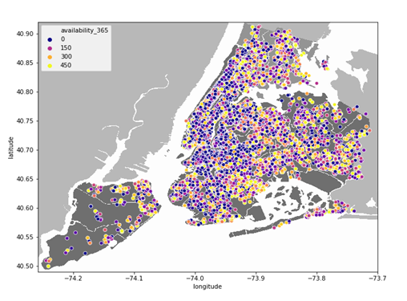
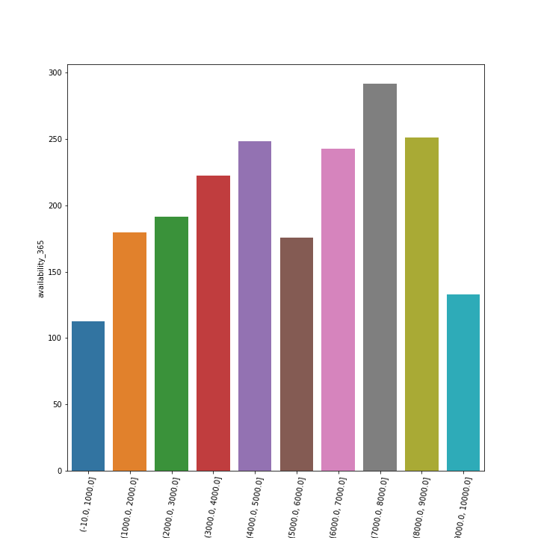
Analysis of Data :
In Manhattan availability of rooms is less as compared to other cities.
There are rooms available in the outskirts of cities.
Cheaper the room lesser is the availability but there are few exception in the price bracket of 5-6k and 9-10k.
Recommendation for Finance Team: -
To attract the customer we can reduce the rent of the room which are mostly available(Outskirts) also we can provide discount plan to customer.

Slide 9
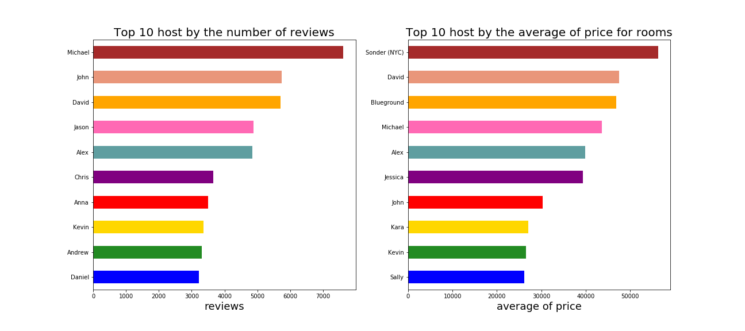
Analysis of Data :
Above visual shows list of top 10 host according to reviews and average price of rooms.
Recommendation Finance and Operation Team: -
Most reviewed hosts should be motivated and rewarded with perks i.e. long term engagement benefits(Free yearly renovation, providing more business)
Host like Sonder ,blue ground ,Jessica need to work on review because they are not present in Top 10 host reviewed list
On the bases on review they can generate more revenue in future.

Slide 10
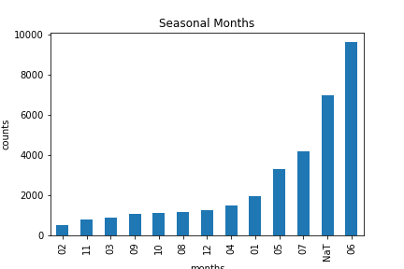
Analysis of Data :
May June and July month is most favourable time to visit because most of the review are post during same duration.
In the month of the June temperature is higher.
For the rest of the month we can provide the room at a discounted rate so that we can grab attention of the customer in off season which would help up to reduce loss in off season and increase annual revenue.
Recommendation for Finance and Marketing:
As per the analysis host should try to list more property in month of may,June and July because as demand increase at the same time rental cost will increases which will help to generate more revenue for company as well as the host.

Slide 11
Feature Engineering / EDA :
EDA :
We tried filling random date on last_review column.
We filled review_per_month column with 0 because we observed that when there is 0 present in number_of_reviews column there is no date and review_per_month values present.
Most of the numberical features where right skewed so we decided to normalize the data using log1p.
We have used label encoding and one hot encoding for categorical data.
We tried to treat outlier using winsorizing technique however it was reduce correlation with respect to target variable.
We tried factorize technique on categorical data to calculation correlation with target and feature variable.From correlation we came to know that host_name is highly correlated but didn’t helped us in reducing rmlse value.
Feature Engineering :
We added new features below are the following :
Days_since_last_review :- we are calculating number of days since the last review.
Seasonal_months :- we have created this data from last_review column to find out seasonality Neighborhood.
Distance :- we have created this distance column using haversine formula which represent the distance in Km.

Slide 12
Model and Hyper Parameter Tuning :
After performing on vanilla model and hyperparameter tuning using Grid search but we found that XGB Regressor is generating lesser RMSLE value as compare to other models.
Model | Rmsle Value
XGB Regressor | 211.86
Ensembleing RF | 219.84
Decision Tree with random Search CV | 223.123
Polynomial Feature | 224.45
Linear Regression(Vanilla model) | 226.22

Slide 13
Conclusion :
If addition details where provide which are mention below.
Number of bedroom , restroom, size of room details should be provided so that we can suggest better room to customer.
Maximum number of guest,that can be accommodate in a room if additional guest are added what charges are applicable.
Historical seasonal pricing column was missing which would help to predict ideal rent.
Additional features related to room i.e. furnished ,unfurnished ,room Condition.
Room listing date so we can predict from start date the growth of the host.
Additional Recommendation for Operational Team:
Customer review should be made mandatory for better analysis.
References Website for insight:
https://www.businessinsider.in/thelife/nyc-rents-just-hit-a-3-year-high-and-the-citys-prices-are-pushing-everyone-from-millennials-to-wealthy-wall-street-bankers-away/articleshow/69879579.cms
https://reason.com/2020/01/27/totally-predictable-consequences-of-new-yorks-rent-regulations/
https://www.businessinsider.in/finance/how-much-it-costs-to-rent-in-28-manhattan-neighborhoods-ranked-from-the-least-expensive-to-the-most/articleshow/64246220.cms

Slide 14


